Slide 1
Challenges and Opportunities in Single Cell Data
Machine Learning for Single Cell Analysis

Slide 2
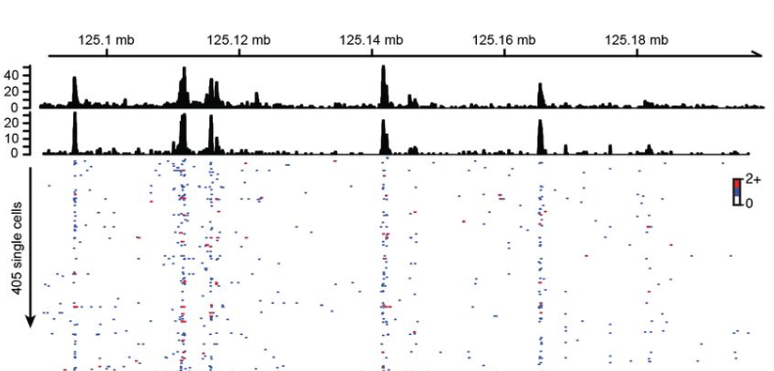
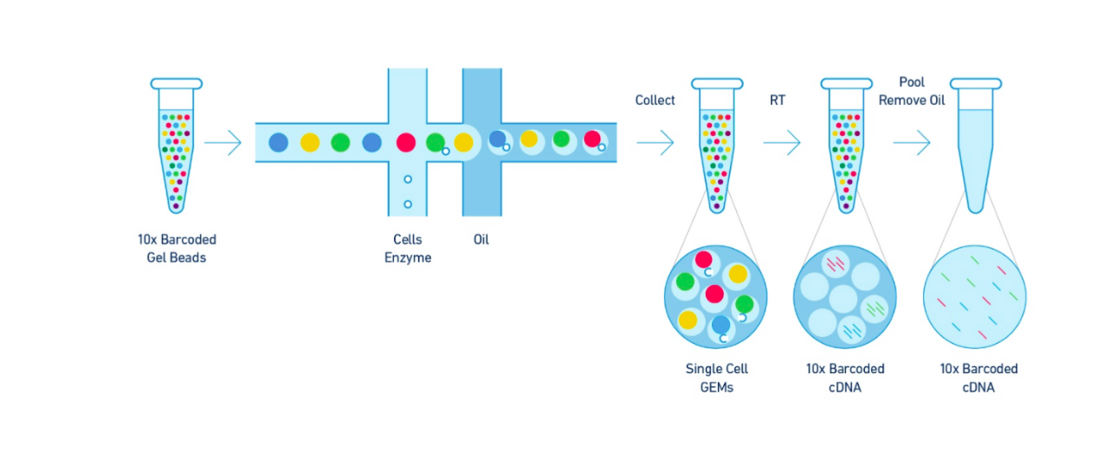
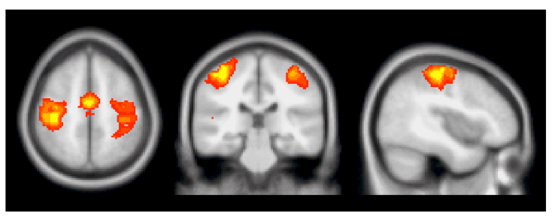

Big Biomedical Data
ScRNA-seq
ScATAC-seq
FMRI
Patient Data

Slide 3
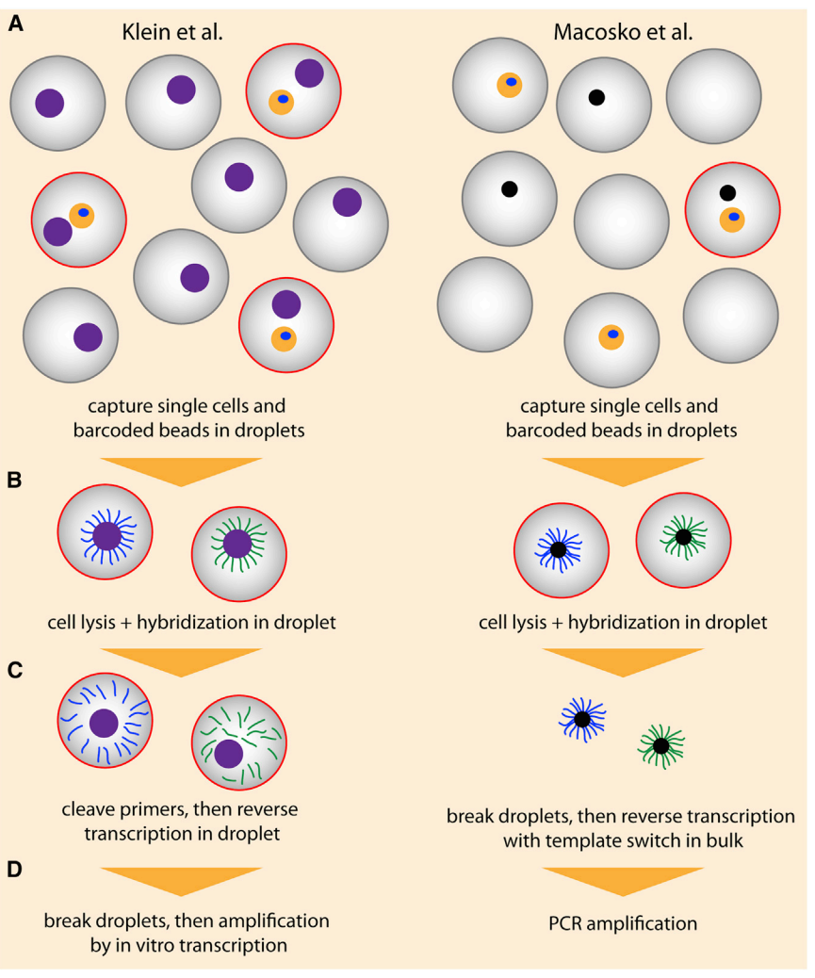
Droplet-based Technologies

Slide 4
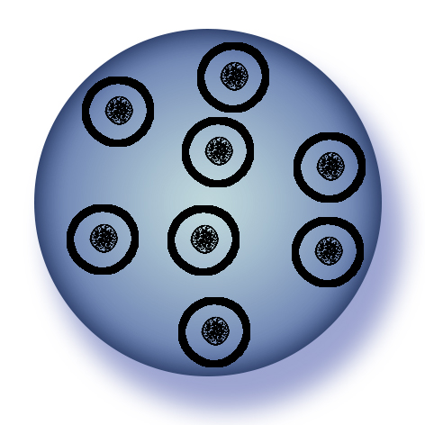
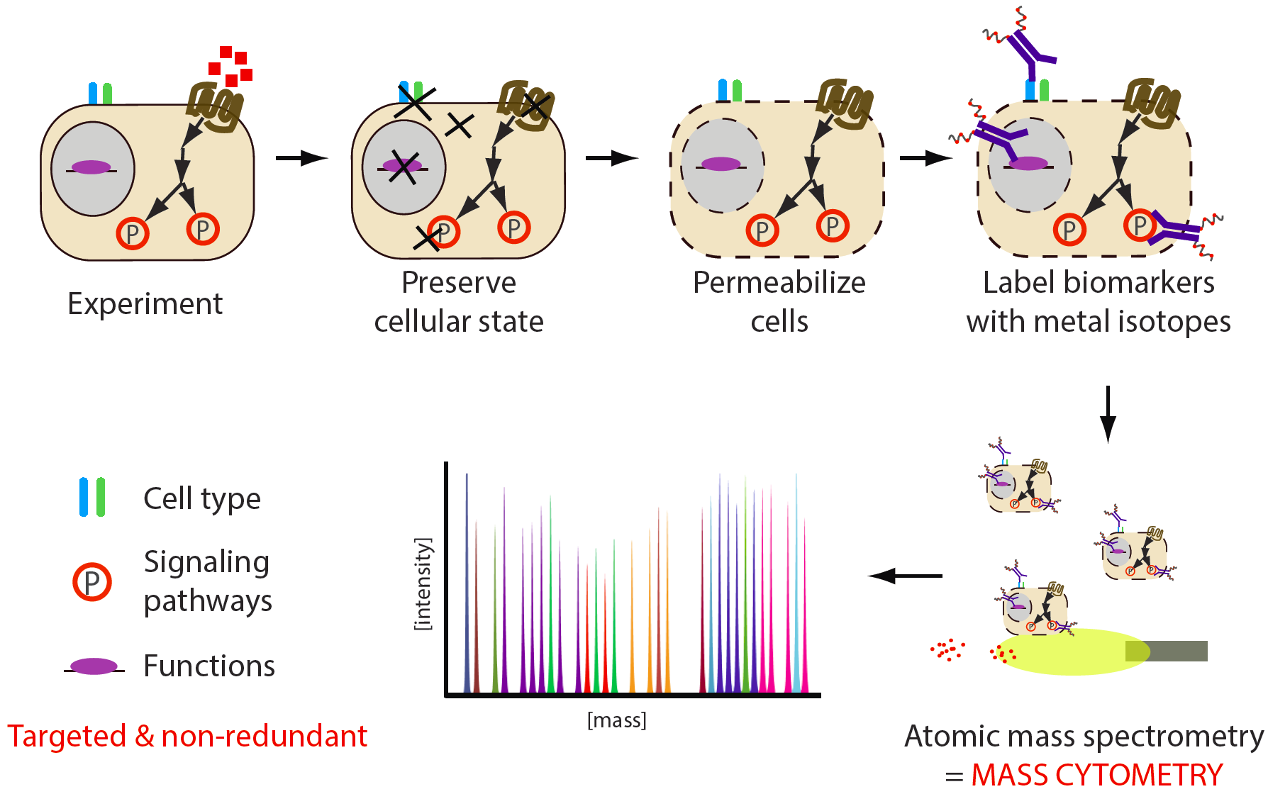
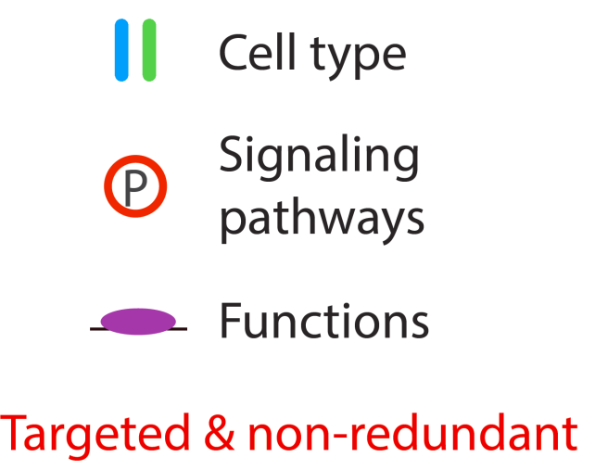
Single-Cell Proteomics: Mass Cytometry

Slide 5
Single Cell Data
Cell 1 = [40 0 20 18 5 0 …]
Each cell is a vector of measurements
The whole data is a matrix with many observations (cells) and features (proteins, genes)
features
[40 0 20 400 5 …]
[35 0 12 50 1 …]
[10 20 5 350 2 …]
[12 020 45 0 0 …]
observations

Slide 6
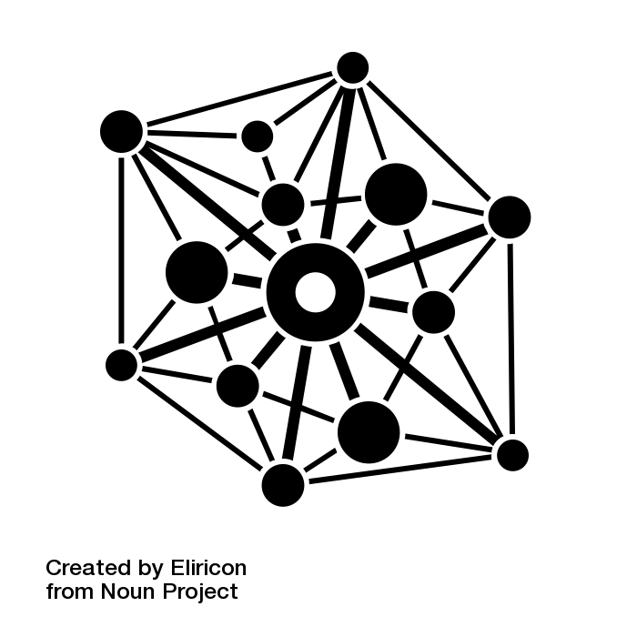
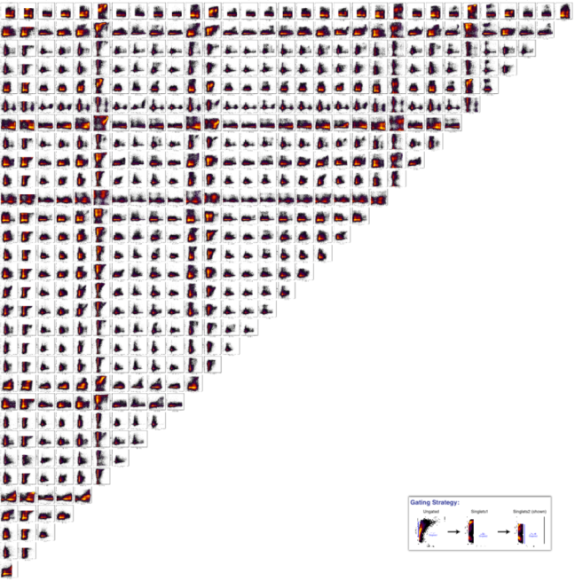

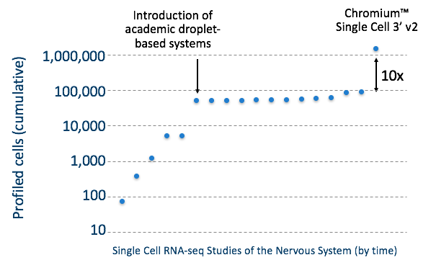

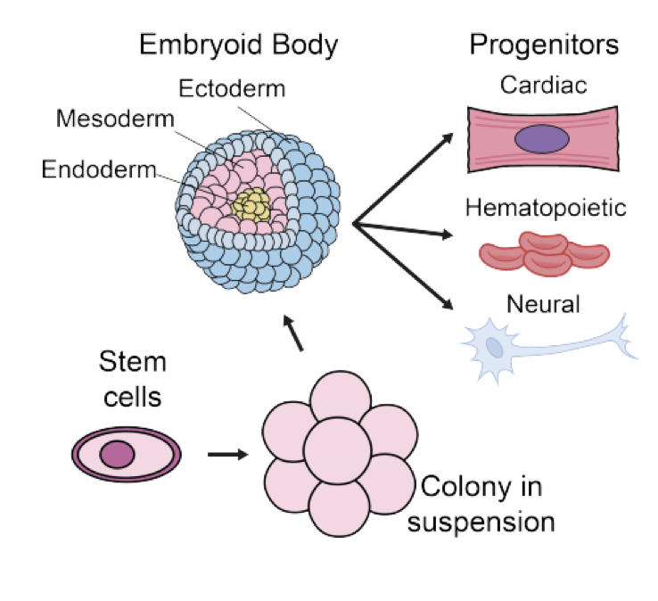
High Dimensional
High Throughput
Heterogeneous
Notes:
Features of this data is that its high dimensional ---gives us a view of the whole system, high throughput – measurements for thousands even hundreds of thousands of cells in each condition. And single cell resolution.

Slide 7



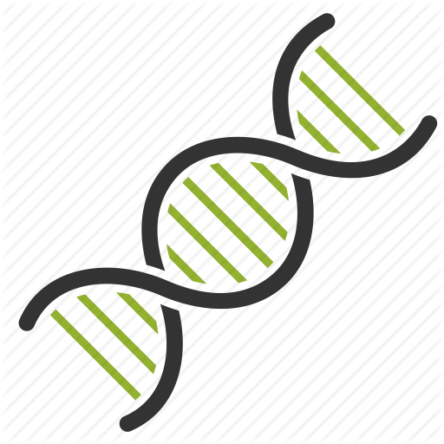



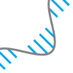
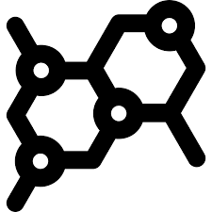
Many dimensions = many measurements
Diagnoses
labs
drug response
assays
ECG
Gene 1
Gene 2
Gene 3
Proteins

Slide 8
High Throughput = Many observations

Slide 9
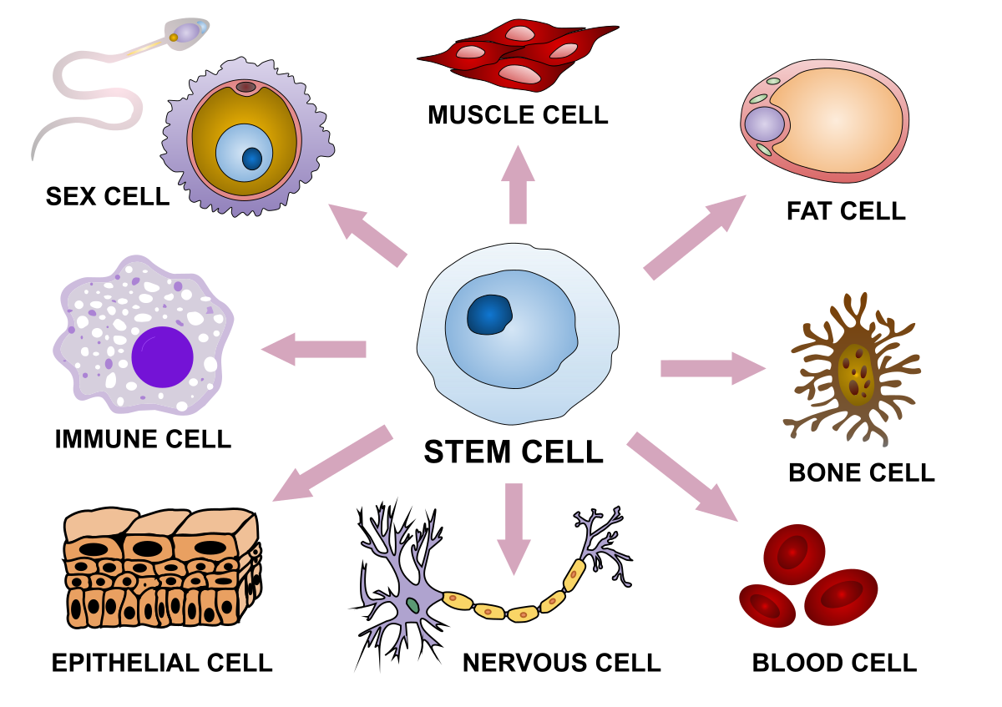

Heterogeneous Observations

Slide 10
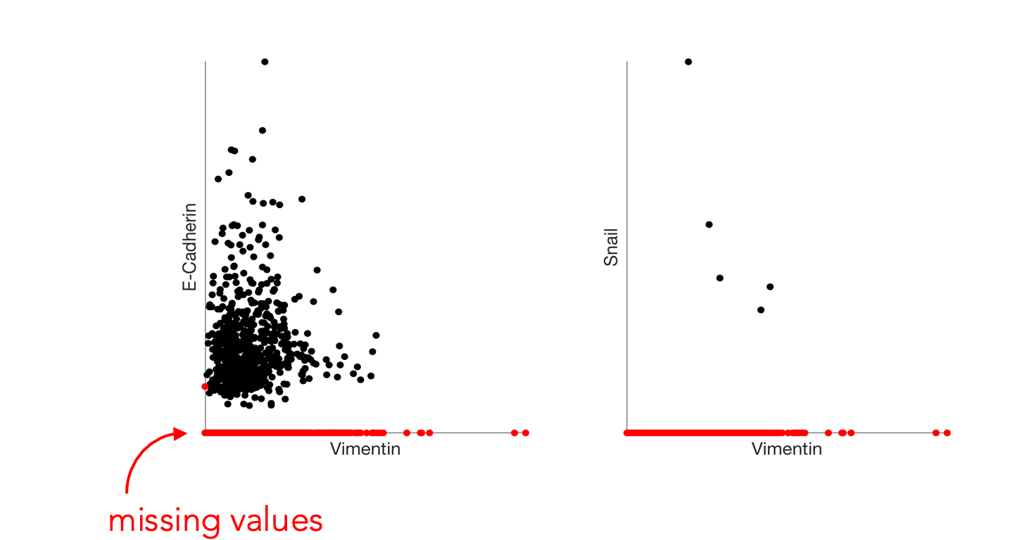
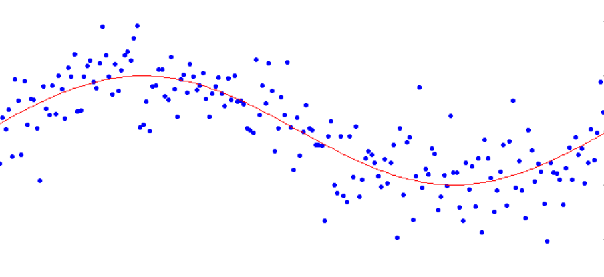
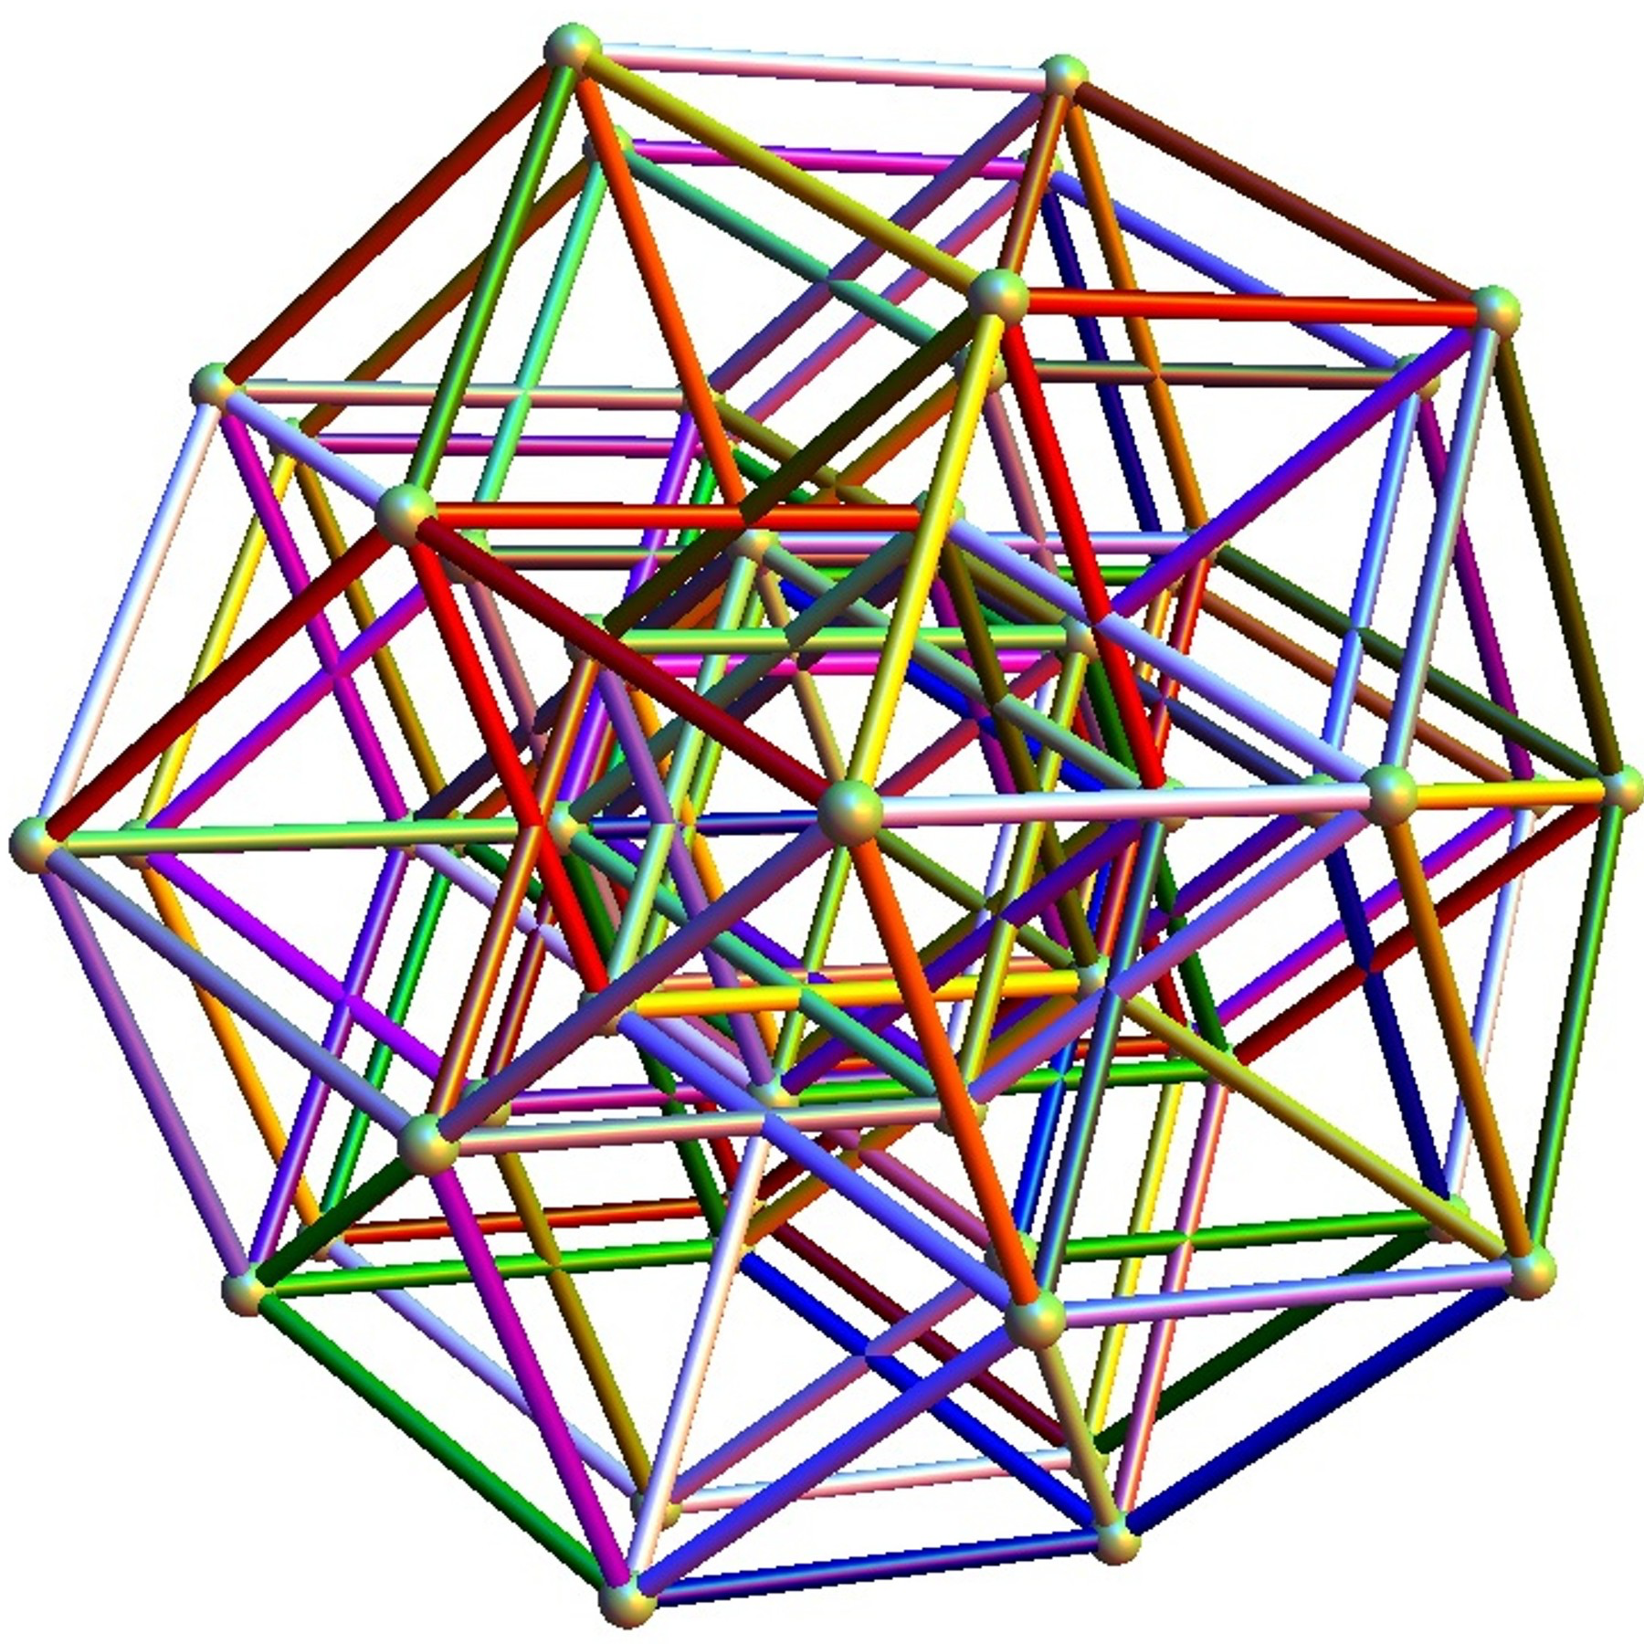

Challenges
Sparsity
Noise
Dimensionality
Scale
Notes:
Features of this data is that its high dimensional ---gives us a view of the whole system, high throughput – measurements for thousands even hundreds of thousands of cells in each condition. And single cell resolution.

Slide 11
Noise

Slide 12
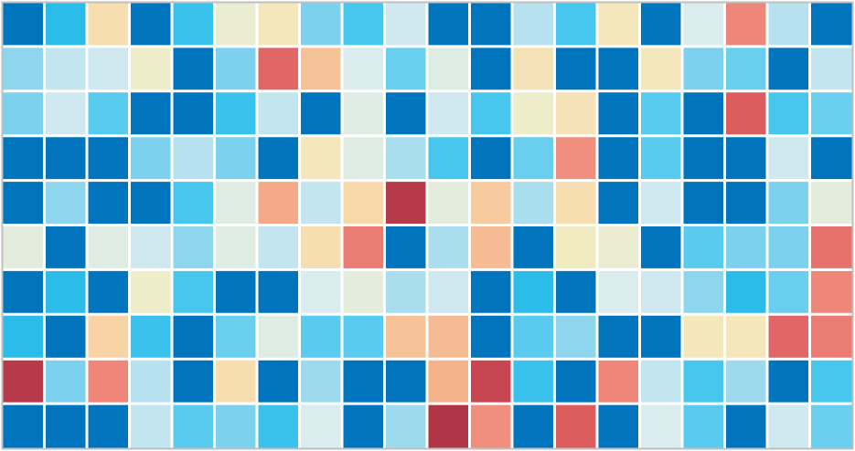
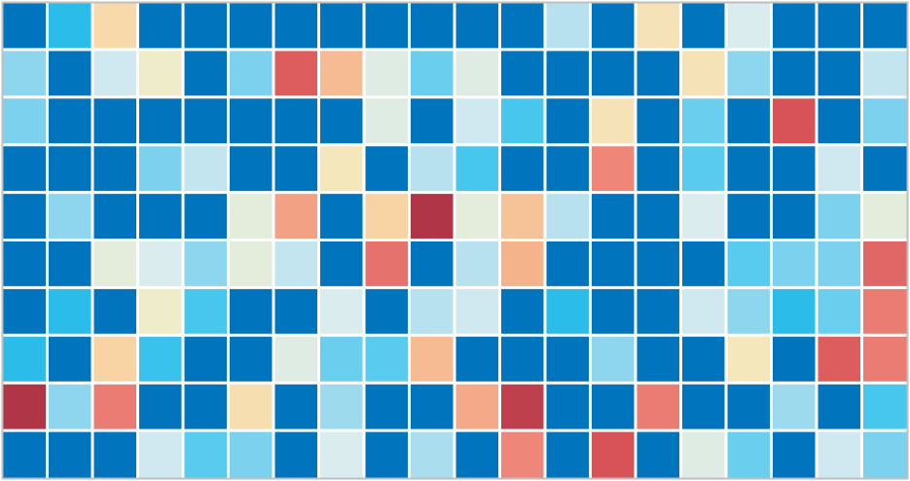
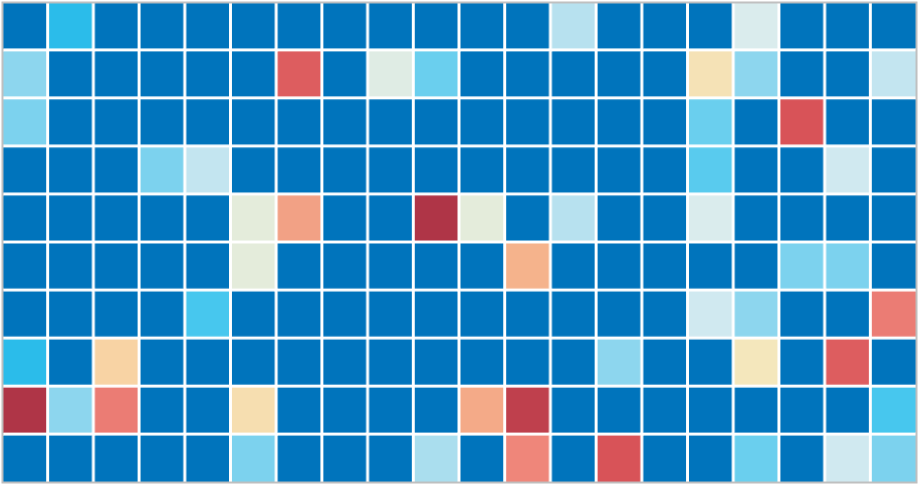
Dropout
Notes:
ideally: measure the expression of every gene in every
Samples only a small part of the transcriptome per cell
-- Tens of millions of individual measurements

Slide 13
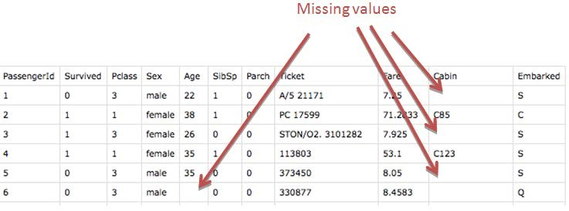
Dropout vs Missing Data

Slide 14
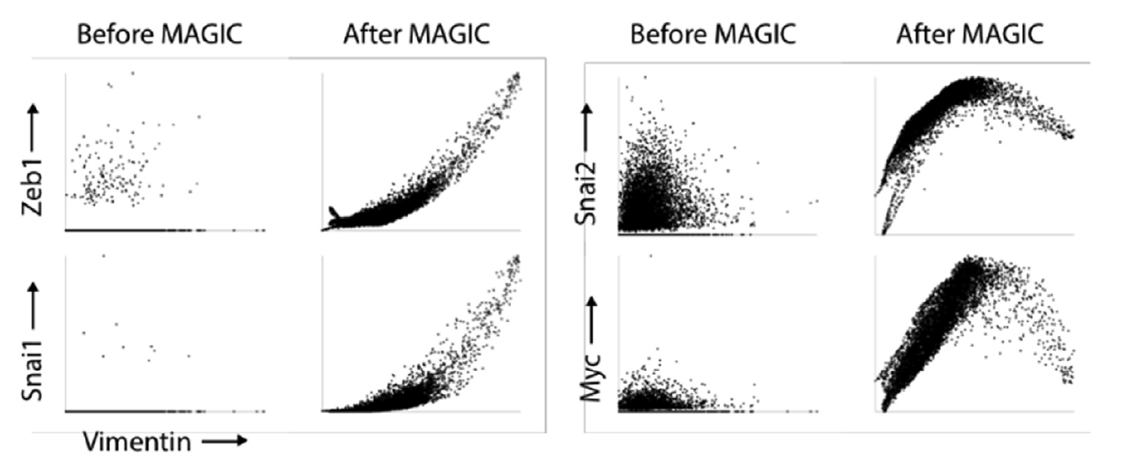
Denoising Data

Slide 15





Gene-gene Relationships
Gene 2
Gene 3
Gene 1
Gene 2
Relationship between features?

Slide 16
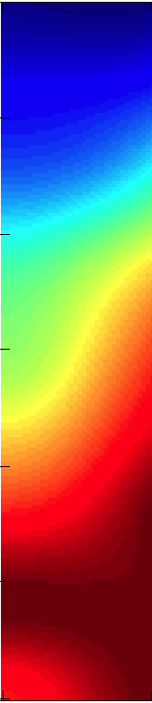

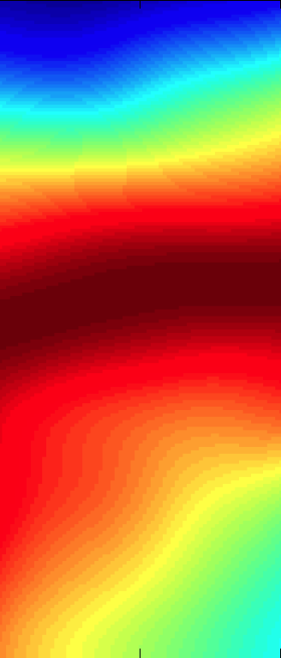

Non-linear Relationships
pCD3z
pSLP76

Slide 17
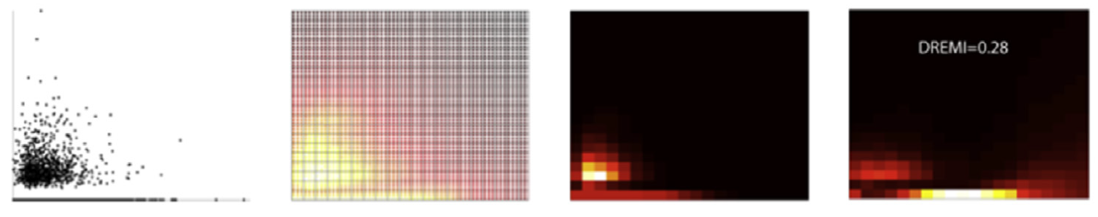
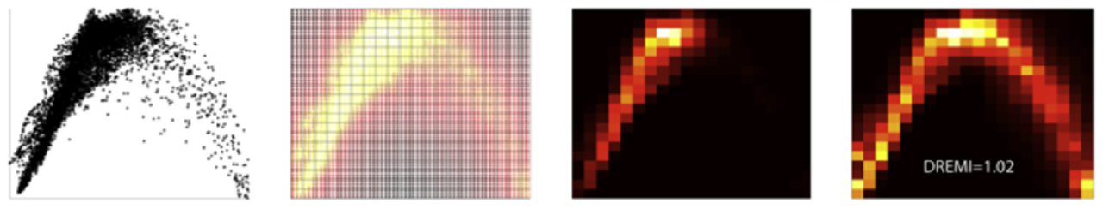
Mutual Information

Slide 18
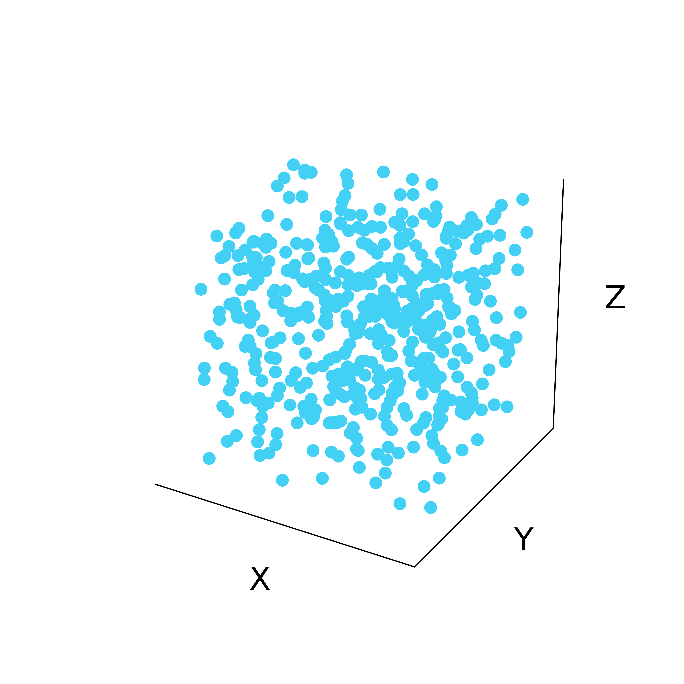
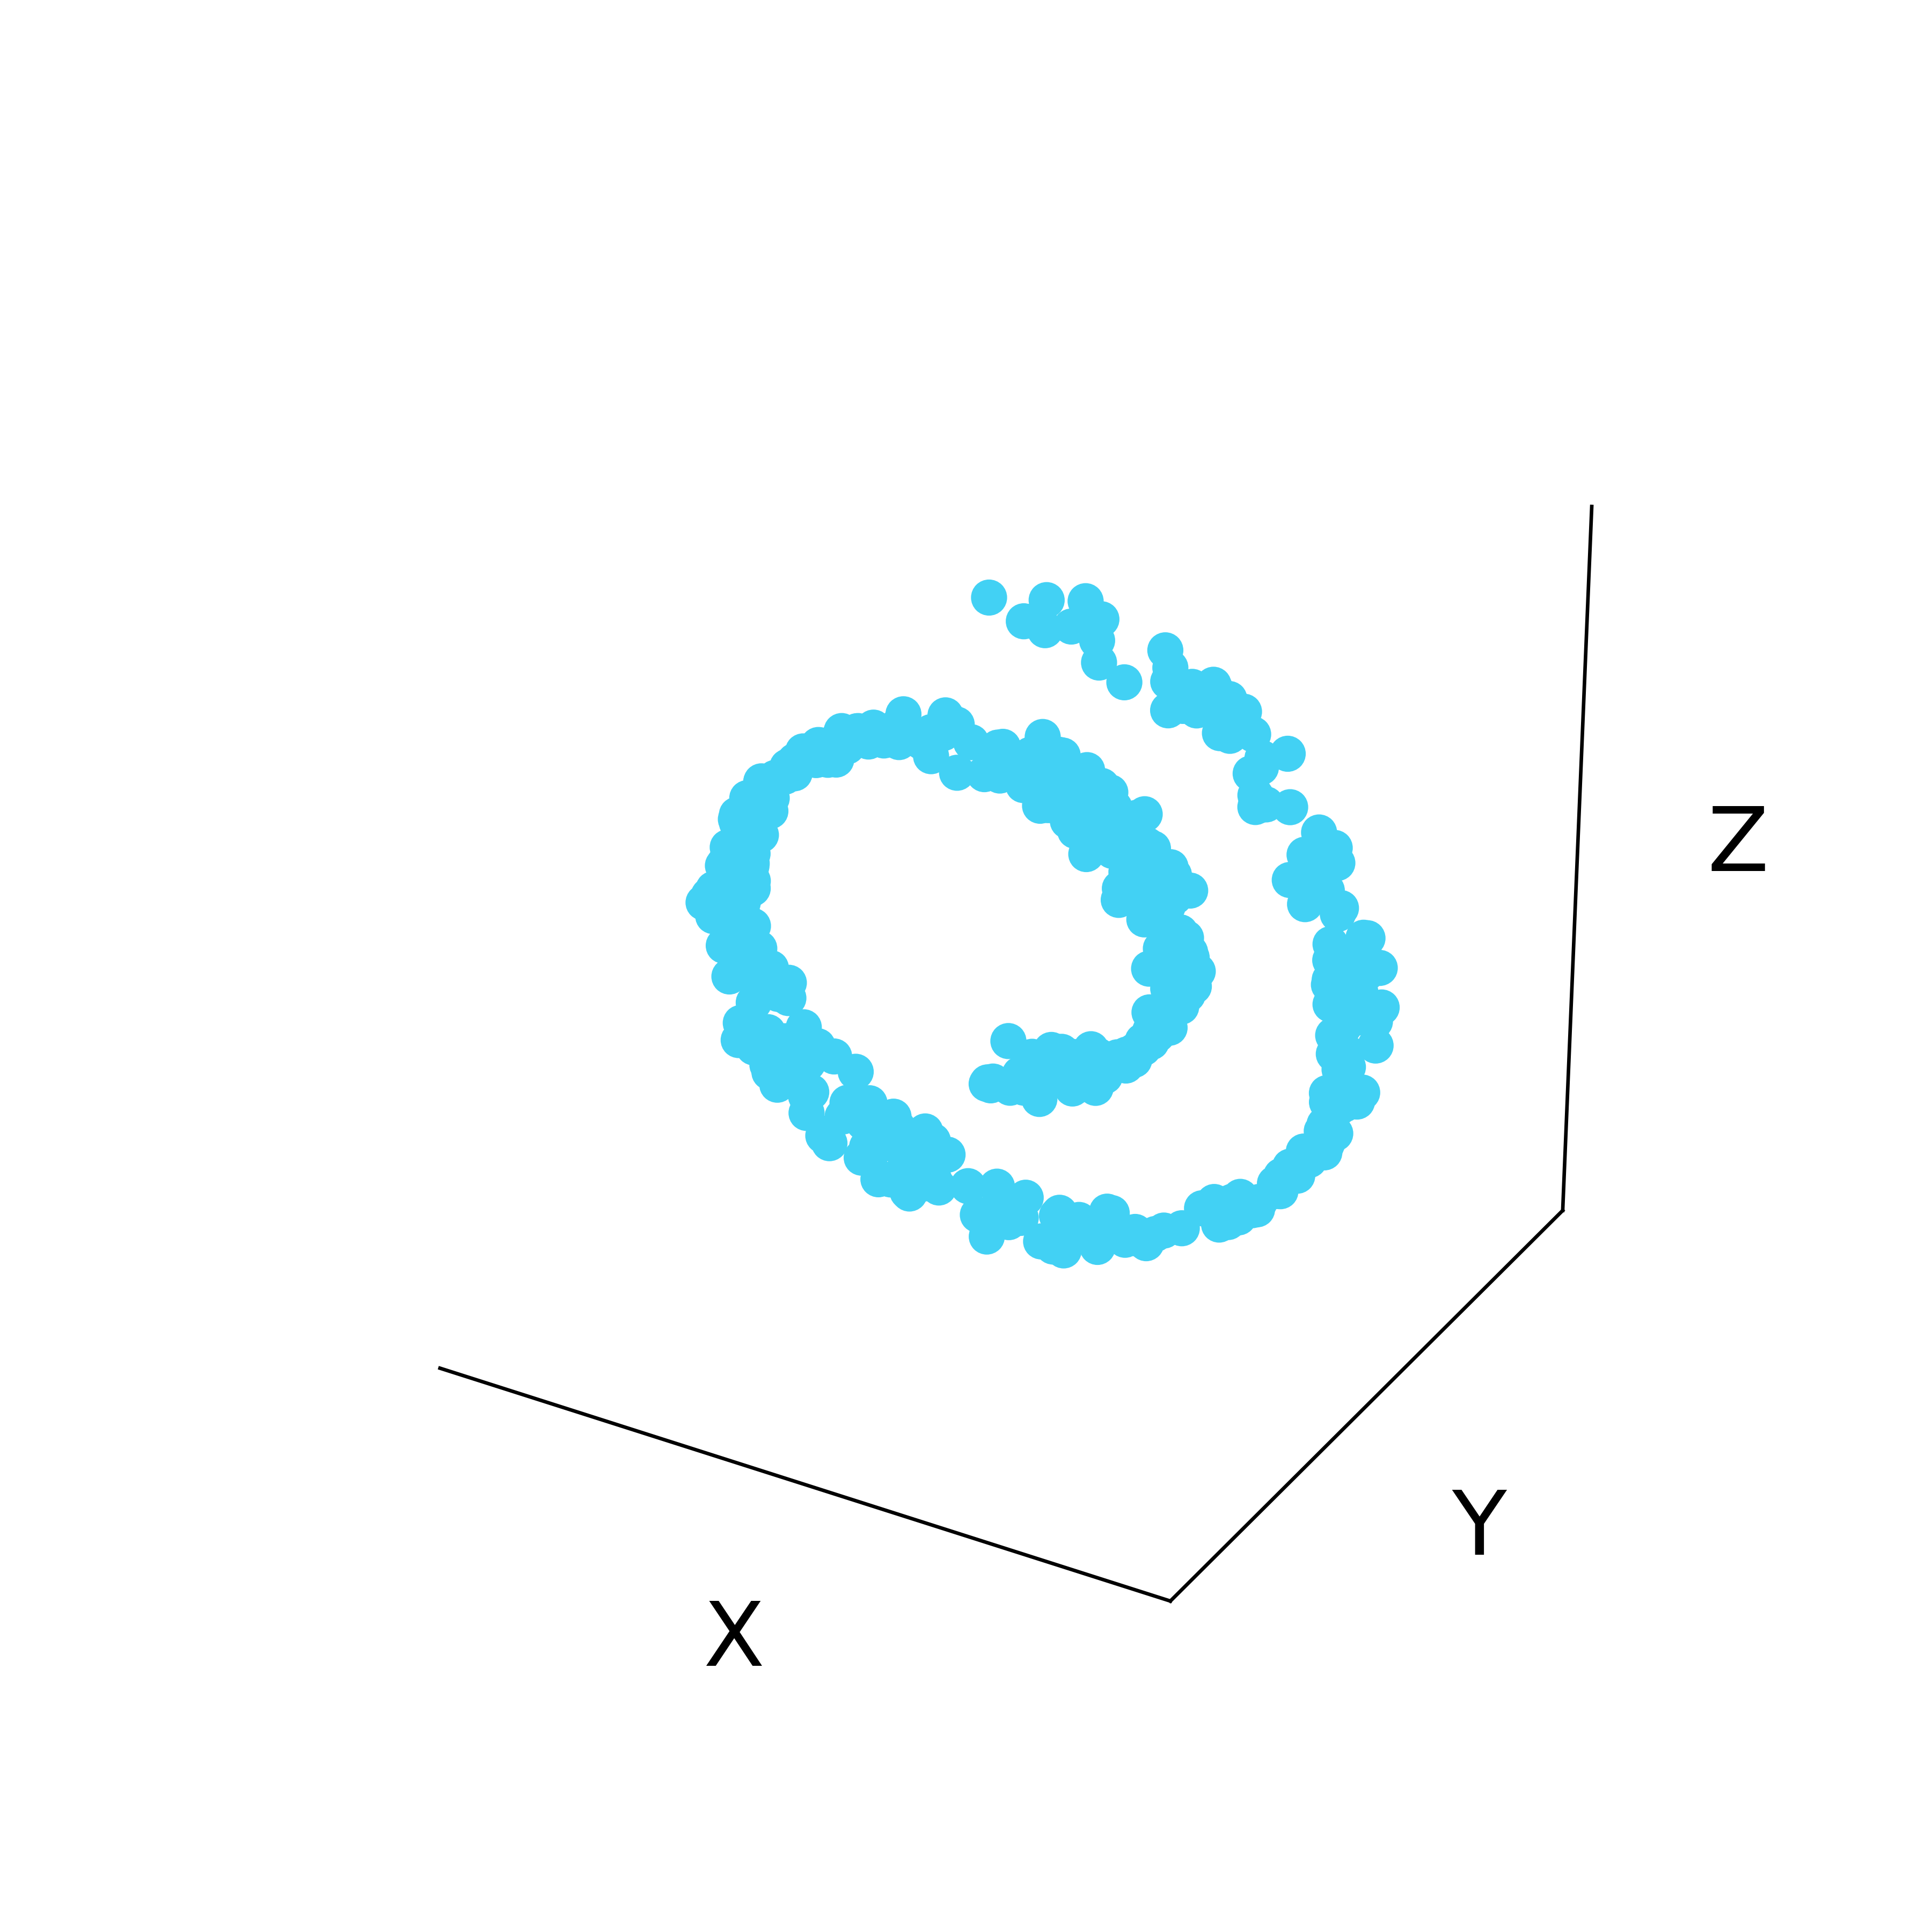
Latent structure in high dimensional data
Low-dimensional
manifold
Ambient Space

Slide 19
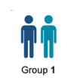

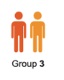
Embedding reveals structure
Dimension 2
Dimension 1
Use high dimensional features and high throughput to understand shape of data
Excellent
Responders
Fair
Responders
Poor
responders
Cluster structure

Slide 20
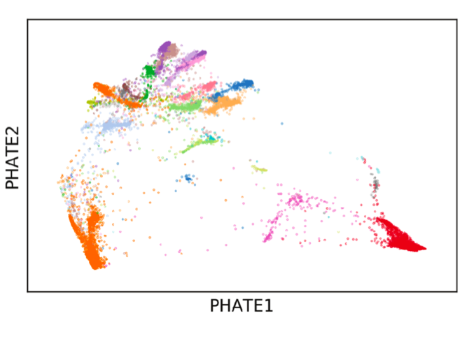
Retinal Bipolar Cells
Notes:
This is what we would want to see.
Cell types are well separated
We can see additional structure that is missed by the manual gating

Slide 21
Progression continuum
Dimension 2
Dimension 1
Use high dimensional features and high throughput to understand shape of data
Pseudotime
Early
Late

Slide 22
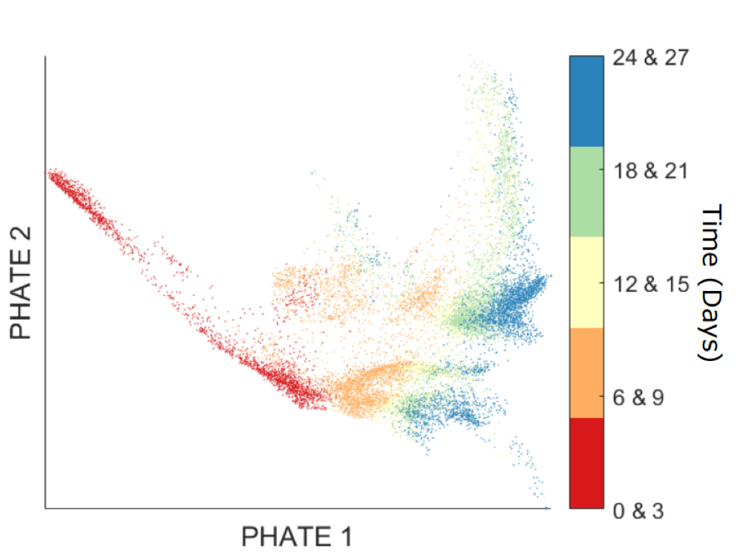
Progressions

Slide 23
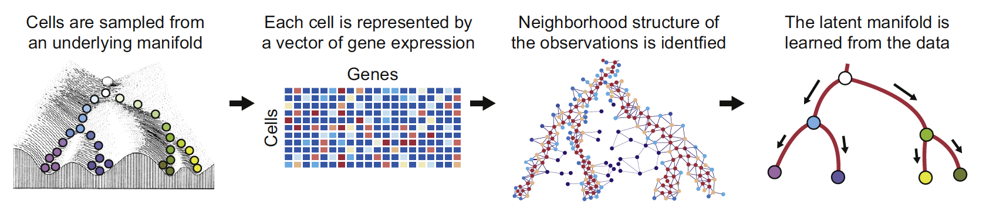
Manifold Learning

Slide 24
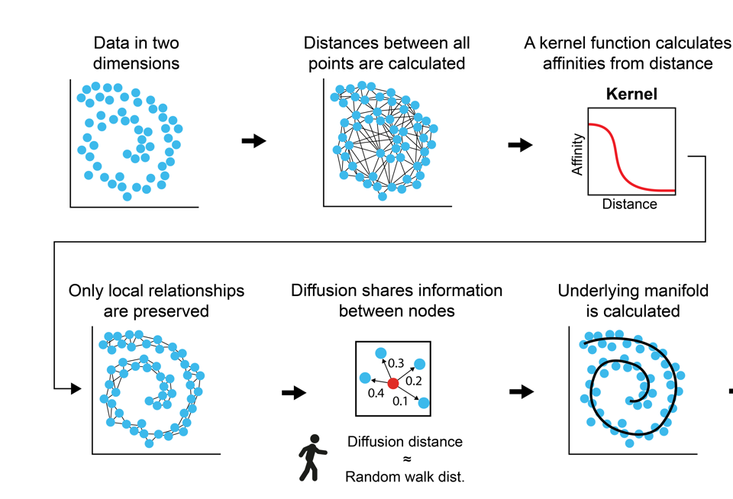

Understanding the shape of data
Notes:
Global distance is not reliable, but local Euclidean steps are
We can use local Euclidean steps to “diffuse” through the manifold
Diffusion is equivalent to a random walk

Slide 25
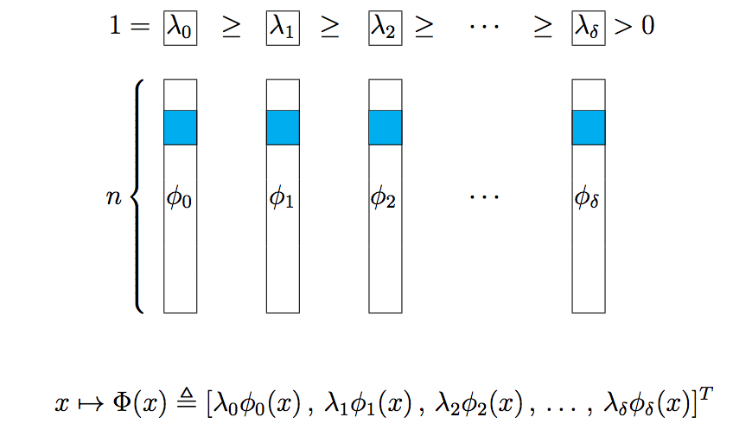
Diffusion Maps
[Coifman, Lafon, ACHA 2006]

Slide 26
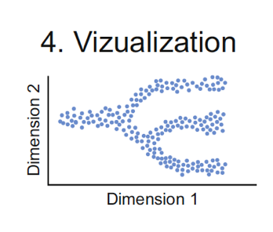

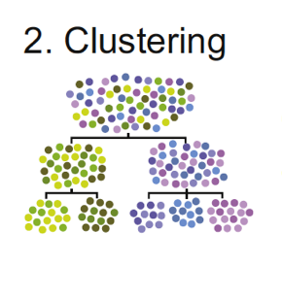
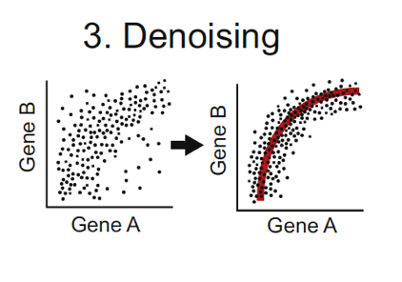
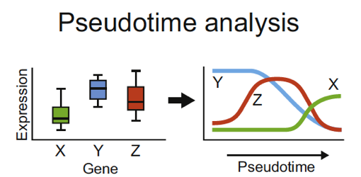
Analysis Tasks

Slide 27
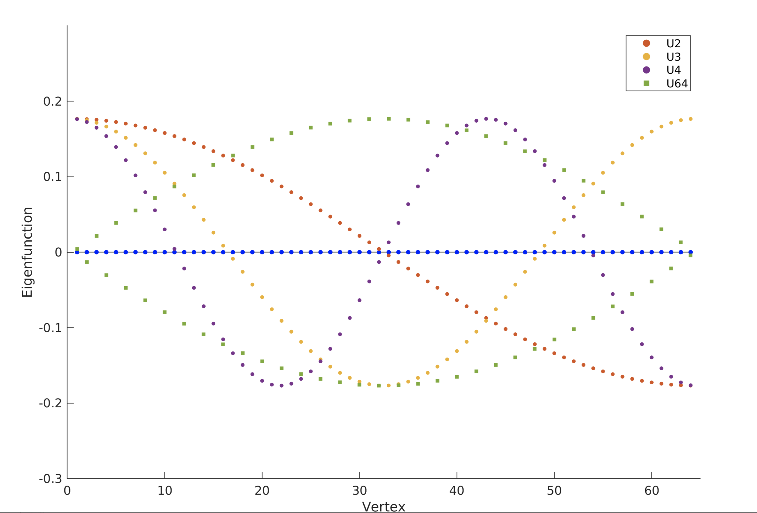
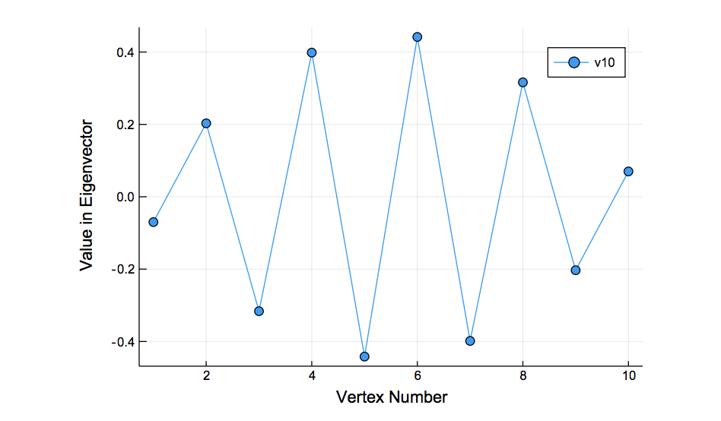
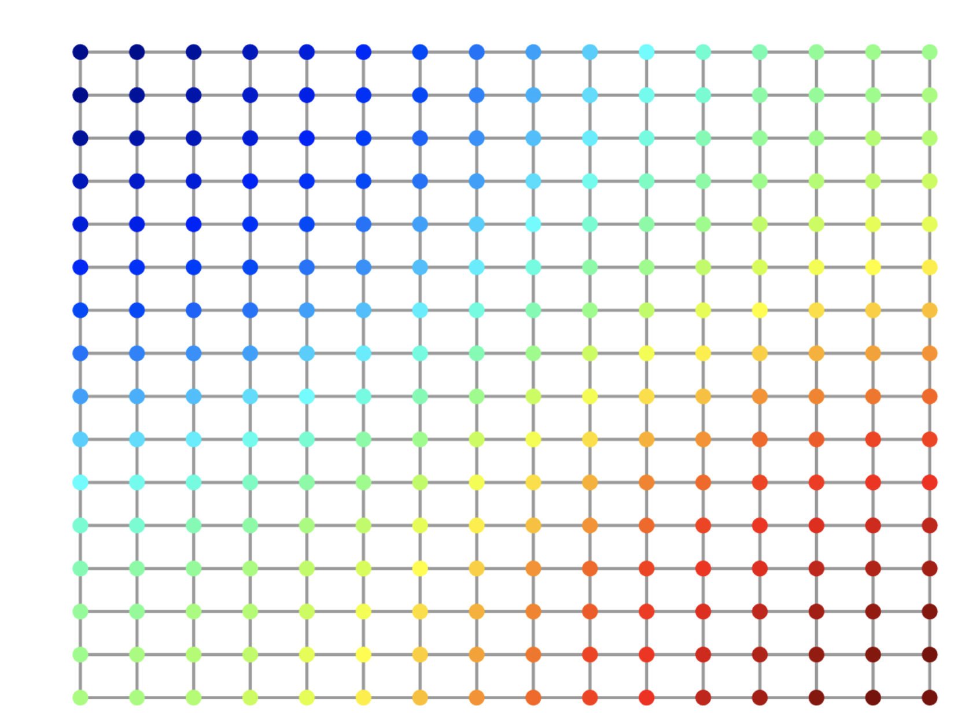
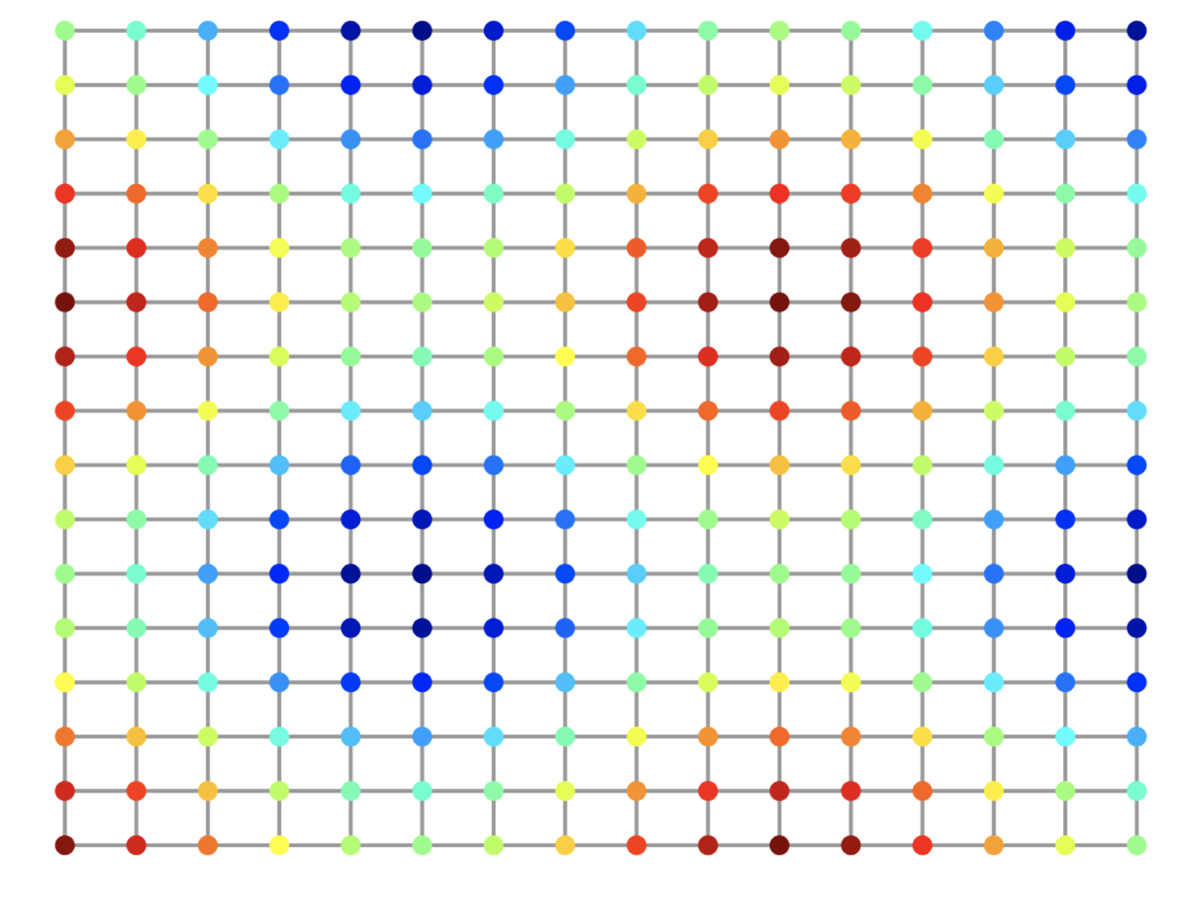
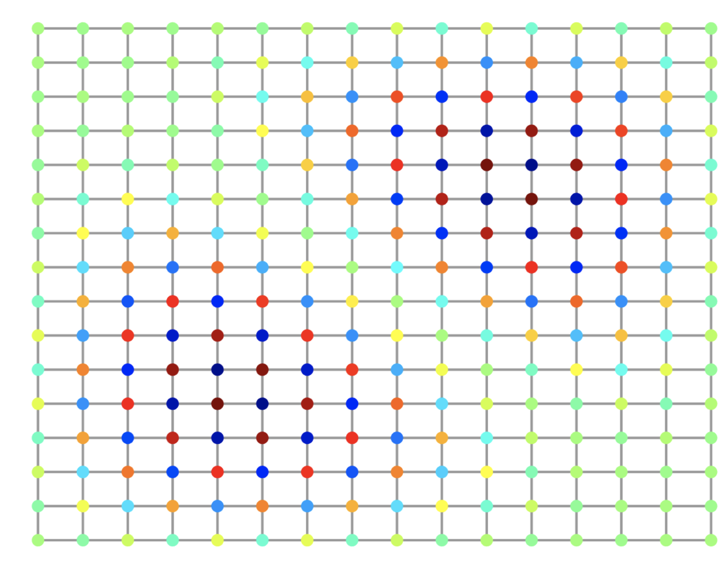
Eigenvectors are frequency harmonics
2nd Eigenvector
10th Eigenvector
2nd to last eigenvector

Slide 28
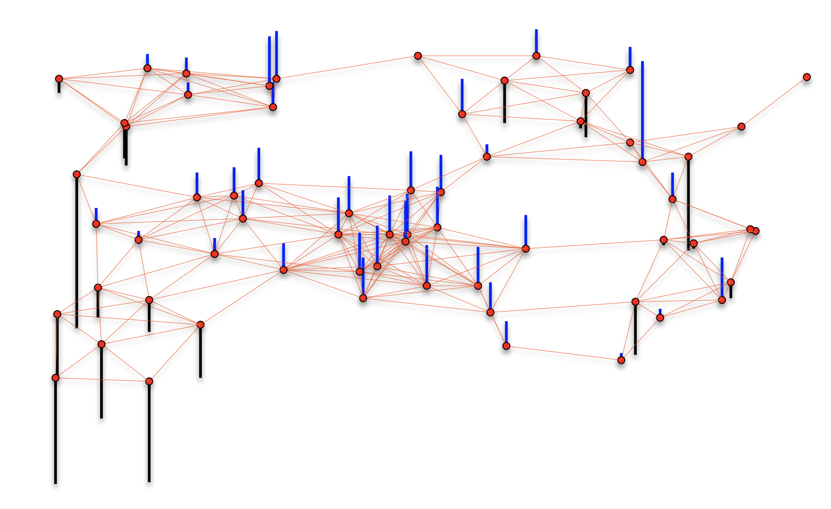
Cells are nodes, mRNA gene-counts are signals on a graph

